Slide 1

Gen AI-Powered Data Profiling
Team Name : Neural Nomads
Neha Anand
Sukriti Bohra
Nikhil Giri
Aishwarya Attanti
Lalitha Ramakrishnan

Slide 2






Challenges & Need for AI-Powered Profiling
Regulatory Compliance: Banks must meet strict reporting standards with accurate data validation.
Need for AI-Powered Profiling: Automating rule generation and anomaly detection improves accuracy and efficiency.
Anomaly Detection Challenges: Identifying irregular transactions is complex and time-consuming.
Lack of Automation: Manual rule creation limits efficiency and adaptability.
Manual Profiling Issues: Traditional methods are slow, error-prone, and hard to scale.
Evolving Regulatory Requirements:Constant updates make manual profiling inefficient and unsustainable.

Slide 3
Our Solution
Anomaly Detection with Reasoning: Combines SQL validation with unsupervised ML (Isolation Forest) and enhances it with natural language explanations leveraging the capability of Gemini.
Automated Rule Generation: Process regulatory instructions and generate profiling rules.
05
01
04
Interactive UI - RBAC(Chainlit):
Auditor: Uploads CSVs, reviews flagged transactions.
Admin: Refines and manages profiling rules, review flagged transactions
SQL Validation: Dynamically generates SQL queries to validate data compliance against extracted rules.
02
03
ADA-Compliant Website: Ensures accessibility for users with disabilities, meeting ADA standards.

Slide 4


















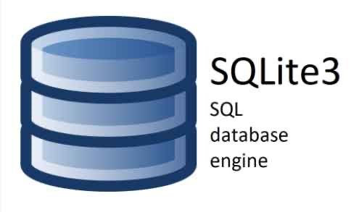


Architecture diagram
FAST
AP I
Middleware and LLM wrapper
Middleware and llm wrapper
Rules and regulations
Transaction CSV
Chat completion
inference API
Rule Engine
Anomaly detector
Persona based access control
User authentication
Upload rules & transactions
Executable SQL commands
Application Interface
SQL executor
SQL result set
Learn
Feedback
RLHF
On-Prem Data base
Rules DB, Transaction DB
Application layer
Middleware
SQL

Slide 5



Tech Stack

Slide 6





Future Scope
Multi-Language Support: Extend rule extraction to handle regulatory instructions in multiple languages.
Broader Reporting Coverage: Expand the solution to cover additional reporting schedules in federal regulatory PDFs.
Real-Time Data Profiling: Enable continuous, real-time validation for live transaction monitoring.
Advanced Anomaly Detection: Integrate more sophisticated ML models for enhanced anomaly detection accuracy.
Personalized User Experience: Persist user preferences for a personalised user experience.

Slide 7
THANK YOU

